Slide 1

Regression Model for Binary Compound Predictions
Ayush Gadpayle

Slide 2
ML Regression Models
Linear Regression (LR)
01
Random Forrest ( RFR)
02
Kernal Ridge (KRR)
04
Gaussian Process Regressor
05
XGBoost
06
Support Vector (SVR)
03
Target :- Formation energy, Crystal volume, and Band gap
Descriptors:- (A+B)/2 and |A-B|/2
Used 20 elemental properties => 50 dimensions (20 + 20 + 10) Descriptors

Slide 3
Random Forrest Model

Slide 4
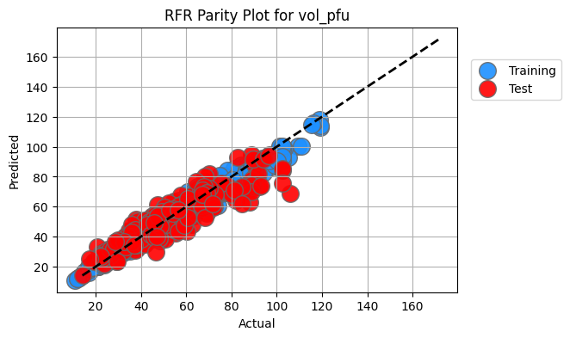
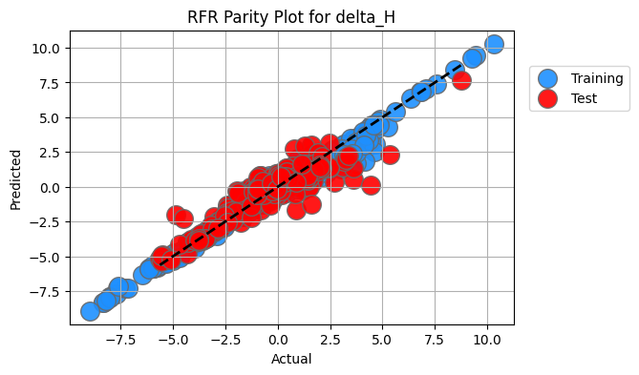
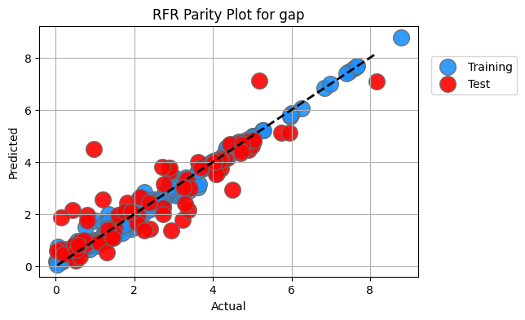
RFR Training Model Summary
 | Train_R2 | Test_R2 | Train_MAE | Test_MAE | Train_RMSE | Test_RMSE
vol_pfu | 0.972661 | 0.841774 | 2.492955 | 6.189580 | 3.191458 | 7.566875
delta_H | 0.965376 | 0.818156 | 0.311912 | 0.594193 | 0.433661 | 0.824364
gap | 0.990258 | 0.816160 | 0.123872 | 0.517531 | 0.182861 | 0.764968

Slide 5
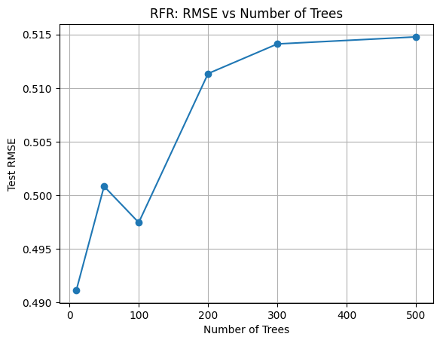
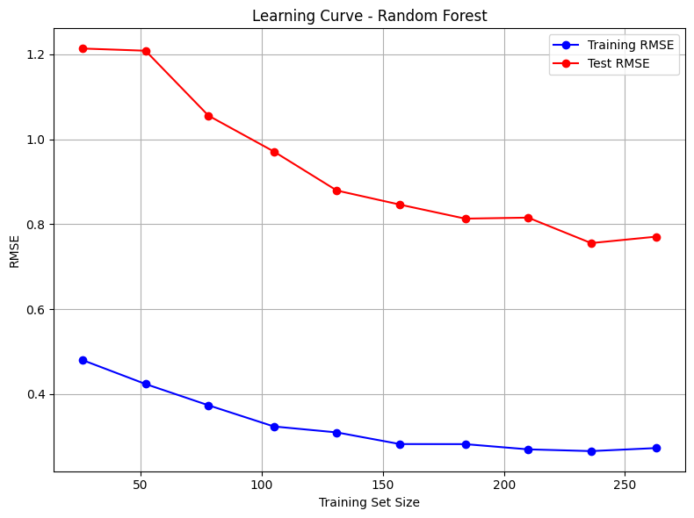

Slide 6
Prediction of all 29k Binary Compounds

Slide 7
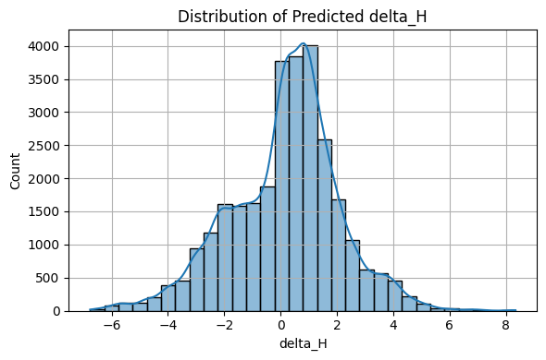
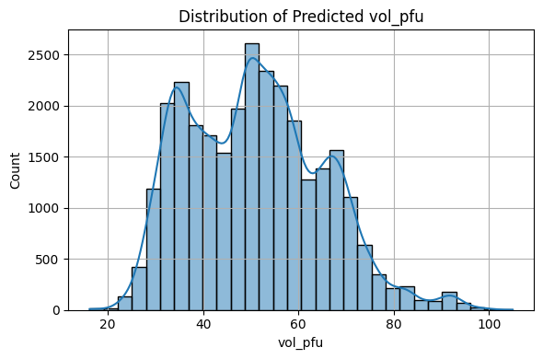
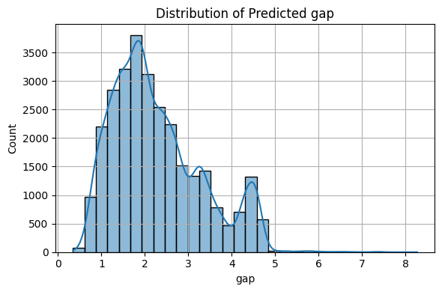
Distribution of Predictions

Slide 8
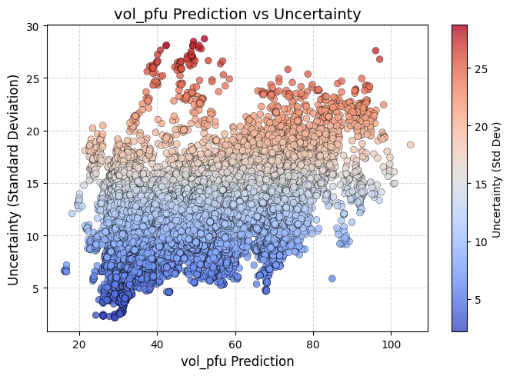
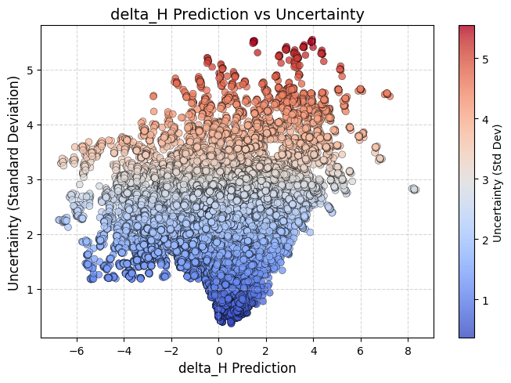
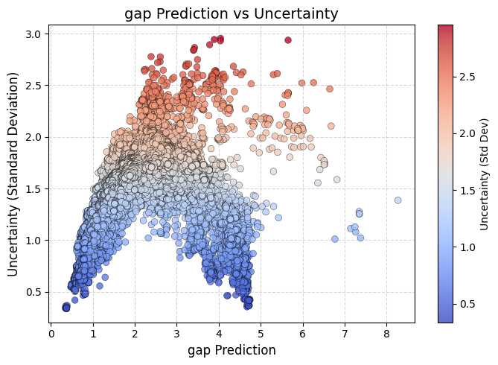

Slide 9
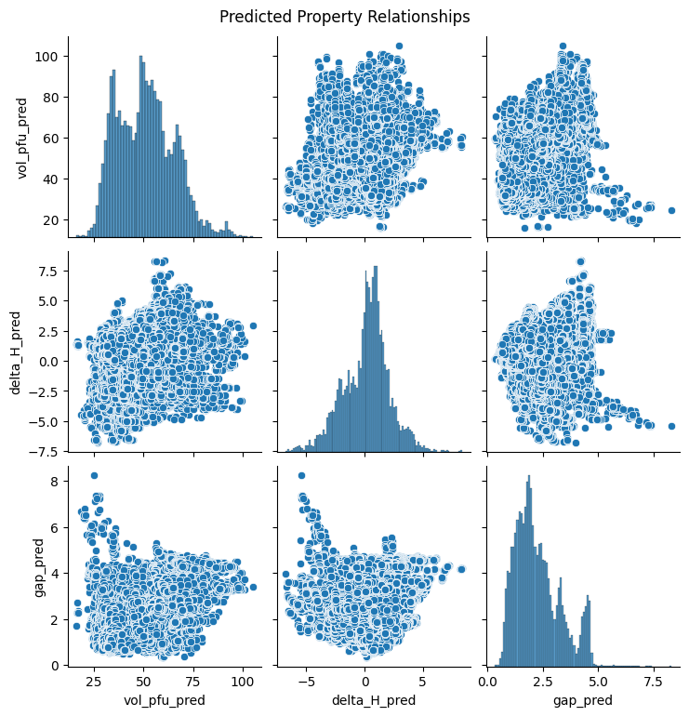

Slide 10
Top 10 Highest Uncertainty Prediction
compound | delta_H_pred | delta_H_std
KW__s3 | 3.963086111111111 | 5.545083415904952
CsRe__s8 | 1.517758333333333 | 5.521752518484826
CsRe__s3 | 1.465425 | 5.519984251472519
KW__s2 | 3.934236111111111 | 5.517984663998434
CsRe__s4 | 1.4878916666666664 | 5.517594
CsRe__s2 | 1.4879916666666666 | 5.514372587495957
KW__s9 | 3.934752777777777 | 5.514322157605833
CsRe__s9 | 1.487558333333333 | 5.512583130625804
KW__s6 | 3.937019444444444 | 5.512494369535351
CsRe__s6 | 1.489825 | 5.511761246326316
compound | gap_pred | gap_std
BeB__s2 | 4.044225109272447 | 2.9545864745140302
OF__s2 | 3.8947528787878793 | 2.9433787014056545
BeF__s2 | 5.6533185185185175 | 2.937089438218264
NF__s2 | 4.041376038221038 | 2.9307397274970524
BeC__s2 | 3.785062103174604 | 2.8926635249051627
BF__s2 | 3.426280461020461 | 2.8652183754691256
FTi__s2 | 3.407029966949844 | 2.8437458538213782
CF__s2 | 3.400809134199134 | 2.839578
FOs__s2 | 2.3896689306773435 | 2.777674723814324
FFe__s2 | 2.6089239115418894 | 2.775542
compound | vol_pfu_pred | vol_pfu_std
NCl__s4 | 52.14518123764387 | 28.72567273425575
NF__s4 | 49.36595786579966 | 28.473854886568084
NO__s4 | 42.38865 | 28.13363807006368
NF__s3 | 49.17092448917628 | 28.10929468779313
OCl__s4 | 50.79615035074583 | 28.095987219734837
NO__s3 | 42.29960170204795 | 28.061752937936117
FCl__s4 | 49.16498086798118 | 28.050248314930982
OCl__s3 | 50.65989411055244 | 27.86583247410485
NCl__s3 | 51.35121119796133 | 27.77572765969492
OF__s4 | 40.84246263292263 | 27.64558734027406

Slide 11
